Slide 1

Chapter 3
Designing and Developing an Agent-based
Model

Slide 2
Learning Objectives
Following this lecture, students will…
Understand the full breadth of considerations needed when designing an agent-based model
Understand the hierarchical nature of design choices in ABMs
Be able to design an ABM through careful elaboration of each aspect of the development process

Slide 3
Lecture Outline
Designing ABMs
Overview
World
Interactions
Agents
Summary

Slide 4
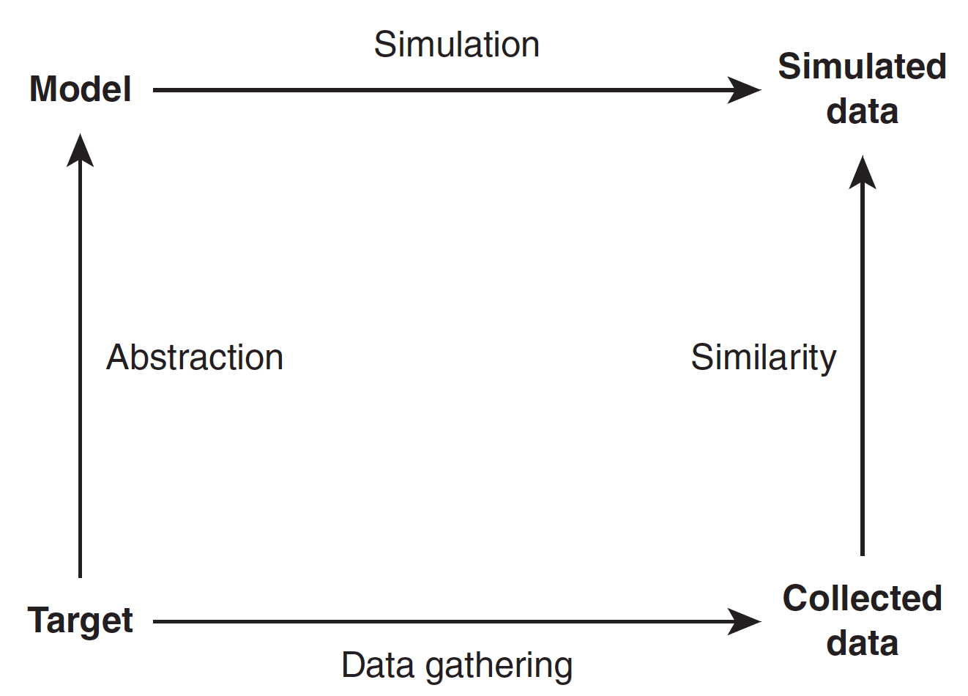
Designing ABMs
Logic of simulation (Source: Gilbert and Troitzsch, 2005, p. 17 )

Slide 5
Designing ABMs
The design of agent-based models is an iterative process, where we integrate theory and data in aiming to explain and predict social systems
While calibration and validation (covered later in the course) can help us tweak model parameters and improve fit, an ABM requires a strong underpinning design
In this lecture, we focus on the considerations required in the design of an ABM

Slide 6
Design Framework
In this book, we introduce a loose framework for ABM design, set into four levels of hierarchy:
Overview – Relating broadly to the wider aims and definitions of the simulation as well as practical considerations
World – Involved with designing the model of the world in which the simulation will take place
Interactions – Design of the nature of interaction and exchange between agents, and the impact on model dynamics
Agents – How agent behavior is designed and encoded at the individual level
Each stage leads to decisions that influence subsequent designs, thus it is advised that this process is conducted in this order

Slide 7
Lecture Outline
Designing ABMs
Overview
World
Interactions
Agents
Summary

Slide 8
Purpose and Process
The very first thing you should do when designing an ABM is explicitly specify:
the purpose for the simulation – why is the simulation needed, and what new is going to tell you about the world?
and the process being simulated – what process will be simulated?
There is a vast diversity of potential responses to these questions, and the answers are likely to be intuitively simple
However, they are important screening questions prior to embarking on ABM development – remember ‘just because you can build an ABM, doesn’t mean you should…’

Slide 9
Data Collection and Evaluation
Once you have your ABM idea in mind, you should think about the datasets you could use to calibrate and validate your modelling
These choices are constrained by context and availability, but thought should also be given over to the strengths and limitations of alternative sources
Having a rough idea of the type of evaluation you’d like to conduct (and will be accepted by your peers) is a good idea at this stage – more details on these considerations follow in a later lecture

Slide 10



Development and Software
How will you develop your ABM? There are lots of packages available, and it is important to examine the strengths and weaknesses of each
Consider simulation scale and computation requirements, and extensions of existing models
It also helps if you can already code in the language the framework uses!

Slide 11
Visualisation
Visualisation will typically come at the end of your ABM development, but it’s important to consider it here
The outputs from your model will influence the scale of development and the software it is developed in
Game development software idea for 3D ABM

Slide 12
Lecture Outline
Designing ABMs
Overview
World
Interactions
Agents
Summary

Slide 13
External Systems
Any ABM has a window of focus, with factors outside of that window simplified in some way
At this point, we identify the area of focus, and the assumptions we make in relation to external systems
Example
Simulations of pedestrian movement focus on street-level interactions, and therefore make assumptions about behaviors outside of this window of interest
We could adopt simplified gravity-based models or historic data to generate origin-destination flows, and we might ignore aspects of agent mood or the football team they support that are uncertain or not relevant to pedestrian movement

Slide 14
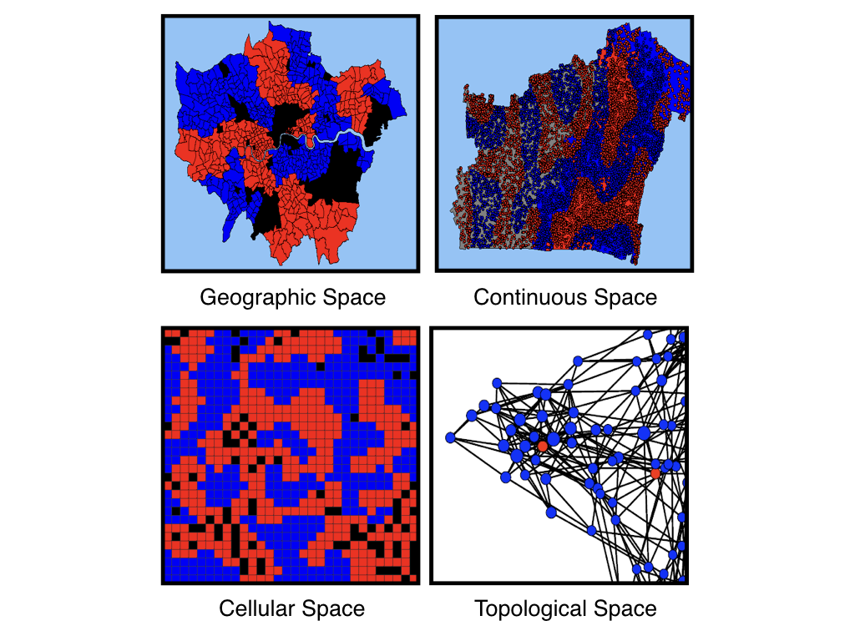
Space
Space can be represented in different ways – tied to real world geographies, or abstract associations
Geographic space will typically draw on GIS datasets
Topological space, also known as network space, represents abstract links between agents (e.g. social networks, trade relations)

Slide 15
Time
Time definitions relate to the dynamics of the modelled system
The simulated ‘time step’ relates to the period of time between simulation updates, or how often an agent might change behaviour
The frequency of these updates relate to the context, but could vary from milliseconds to days and years
Choice of time step influences how long your model will take to run
A traffic model might update the position of vehicles every second
A migration simulation could update movements on a monthly basis

Slide 16
Populations
This defines our groups of agents, which will be modelled in different ways at lower levels of our design process
We should ensure we capture all of the agent groups required to capture the observed social dynamics accurately
These definitions help with the later specification of the model, but more specific definitions about the agents are made at lower levels in the hierarchy

Slide 17
Physical Rules
Finally, we must design the physical rules and forces that will act upon our simulation ‘world’
We will define the exact nature of these interactions next, but we should first define the broader physics involved in our simulation
Does gravity have an effect? Does it matter?
How are physical interactions captured? Do agents respond according to Newtonian forces?

Slide 18
Lecture Outline
Designing ABMs
Overview
World
Interactions
Agents
Summary

Slide 19
Physical Interactions
Having defined our ABM ‘World’, we now define the behaviours of our populations of agents
Physical interactions follow the rules set down at ‘World’ level, but relate to interactions within and between different agent groups
Physical interactions might be benign – such as the forces of attraction and repulsion involved in flocking simulation
Or they might be damaging for an agent – such as the ‘interaction’ between a wolf and sheep
Agents also interact with their spatial environment, being constrained or repulsed by features in space

Slide 20
Communication
This relates to the design of how agents communicate, leading to the exchange of resources or information
Communication channels may be limited by spatial proximity, or constrained to interactions across a topological network
It may also be limited to one-way interaction, where a hierarchy exists
Multiple forms and frequencies of communication can exist between different agent groups

Slide 21
Resource Exchange
Exchanges of resources could be a good or bad thing for an agent – from exchanging goods or information, through to disease
The movement of resources from one agent to another is an important aspect in simulating a social system
The network of resource flow may govern the emergence of new social norms, such as the redistribution or accumulation of resources

Slide 22
Lecture Outline
Designing ABMs
Overview
World
Interactions
Agents
Summary

Slide 23
Characteristics
One we have made our definitions of agent interaction, we can start capturing heterogeneity at the agent level
Characteristics refer to the attributes of the agents
We should limit these definitions to those factors most pertinent to the simulation dynamics
Characteristics can be defined randomly across a population of agents though defining a probability distribution from which the characteristic will be drawn

Slide 24
Decisions
Agent decisions govern how the simulation evolves, so require careful thought
However, many of the constraints on decision-making have been made at higher levels – such as spatial definitions, interaction pathways, and characteristics
Decisions can be modelled in a variety of ways – there is a whole separate presentation on these approaches!
Agents will typically combine their own characteristics and perceptions in shaping the decision, so as a designer you must specify the type of information that is made available to an agent

Slide 25
Actions
Once a decision as been made by an agent, it typically leads to an action, so here we must define these responses
An action could be a physical movement, an interaction with another agent, or simply a change to an agent’s internal state
All actions are shaped by the choices made at higher levels in relation to space, time, interaction pathways, and so on.
Actions can also occur on a temporal basis, either randomly or scheduled at regular intervals
It is likely that agents will incorporate multiple actions, from mundane actions (such as ’move’) to more complex interactions

Slide 26
Lecture Outline
Designing ABMs
Overview
World
Interactions
Agents
Summary

Slide 27
Summary
This lecture has introduced a variety of considerations that need to be applied when building an agent-based model
As has been shown, ABM development involves theoretical, practical, and scientific aspects of design, with each component potentially affected by prior design choices
By considering each aspect of this process incrementally, a complete design of the ABM can be constructed, limiting the potential for missed detail or poor configuration

Slide 28
Further Reading
For a good overview on considerations when designing an agent-based model, readers are referred to:
Kornhauser, D., Wilensky, U. and Rand, D. (2009), ’Design Guidelines for Agent Based Model Visualization’, Journal of Artificial Societies and Social Simulation, 12(2), Available at http:// jasss.soc.surrey.ac.uk/12/2/1.html.
Abdou, M., Hamill, L. and Gilbert, N. (2012), ’Designing and Building an Agent-Based Model’, in Heppenstall, A., Crooks, A.T., See, L.M. and Batty, M. (eds.), Agent-based Models of Geographical Systems, Springer, New York, NY, pp. 141-166.
Pattern oriented modelling (POM) and the Overview, Design concepts and Details (ODD) protocol are important developments in the agent-based modelling methodology and were only briefly mentioned here. The interested reader could begin with the main papers:
Grimm et al., 2005Grimm, V., Revilla, E., Berger, U., Jeltsch, F., Mooij, W.M., Railsback, S.F., Thulke, H., Weiner, J., Wiegand, T. and DeAngelis, D.L. (2005), ’Pattern-Oriented Modelling of Agent-Based Complex Systems: Lessons from Ecology’, Science, 310: 987-991.
Grimm, V., Berger, U., Bastiansen, F., Eliassen, S., Ginot, V., Giske, J., Goss-Custard, J., Grand, T., Heinz, S., Huse, G., Huth, A., Jepsen, J., Jorgensen, C., Mooij, W., Muller, B., Pe’er, G., Piou, C., Railsback, S., Robbins, A., Robbins, M., Rossmanith, E., Ruger, N., Strand, E., Souissi, S., Stillman, R., Vabo, R., Visser, U. and Deangelis, D. (2006), ’A Standard Protocol for Describing Individual-Based and Agent-Based Models’, Ecological Modelling, 198(1-2): 115?126.
Grimm, V., Berger, U., DeAngelis, D.L., Polhill, G.J., Giske, J. and Railsback, S.F. (2010), ’The ODD Protocol For Describing Individual-Based And Agent-Based Models: A First Update’, Ecological Modelling, 221(23): 2760-2768.
Mller, B., Bohn, F., Dreler, G., Groeneveld, J., Klassert, C., Martin, R., Schlter, M., Schulze, J., Weise, H. and Schwarz, N. (2013), ’Describing Human Decisions in Agent-based Models - ODD + D, An Extension of the ODD Protocol’, Environmental Modelling & Software, 48: 37-48.

Slide 29
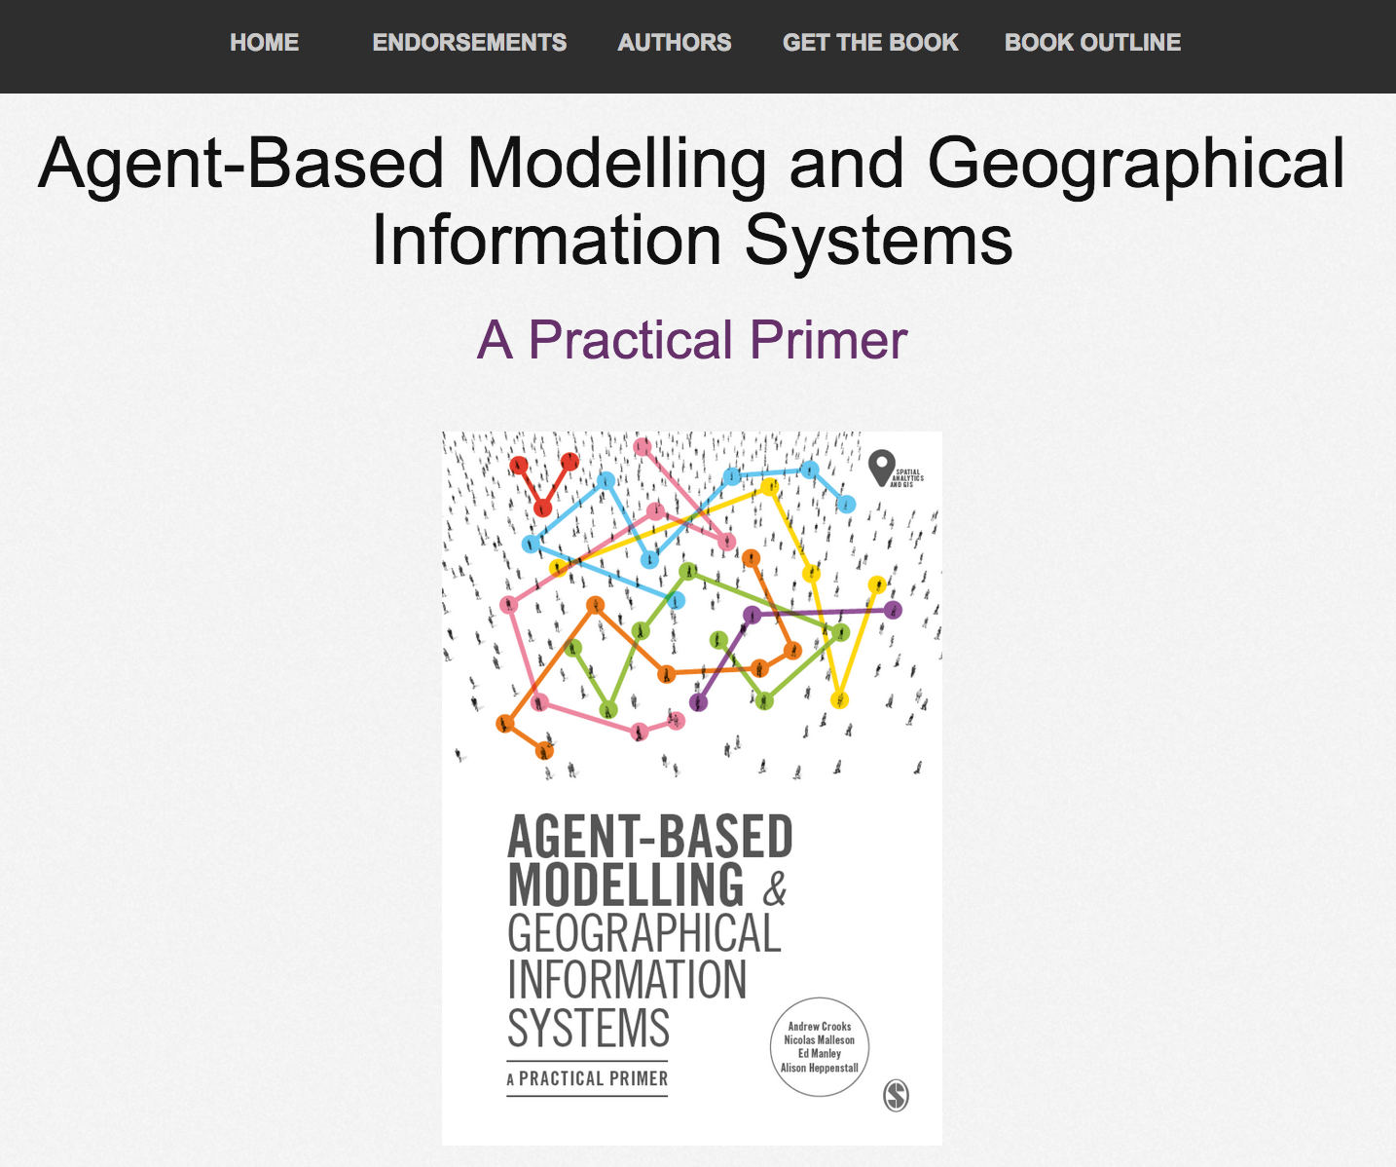
Online Resources
Visit: www.abmgis.org/Chapter3.html for a selection of models to highlight core concepts introduced in this chapter

